Slide 1


Slide 2


01
02
Table of content
03
04
Key message & Features
Target Audience
Media & methods
Endorsment & special promotions

Slide 3
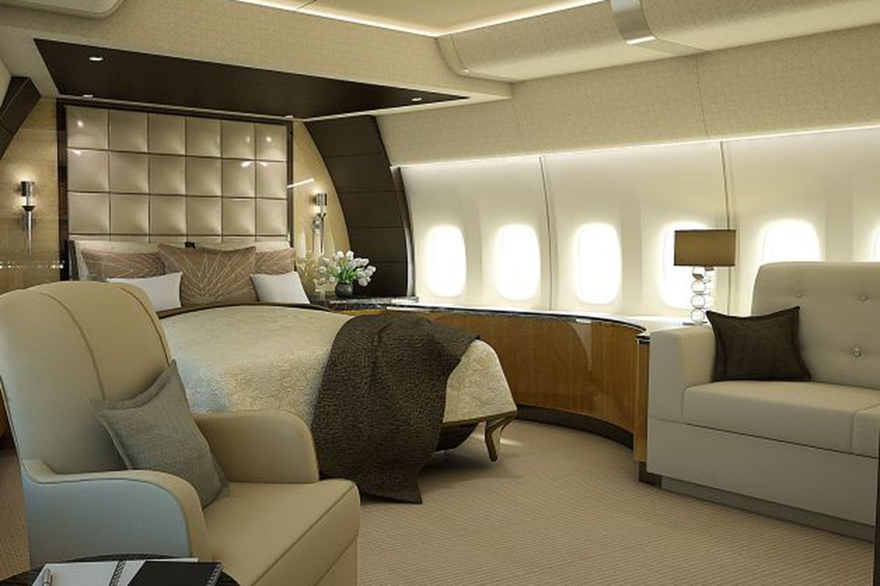
“Let your dreams take flight”
Experience space and comfort on board in our Business Class cabin.
Comfort with reclining seats.
Enjoy direct aisle access or rejuvenate featuring skin care products.

Slide 4
01
Key message & Features

Slide 5
01
02
03
04
Safety
Quality
Fancy
Services
Competitive
Prices

Slide 6

01
Safety

Slide 7
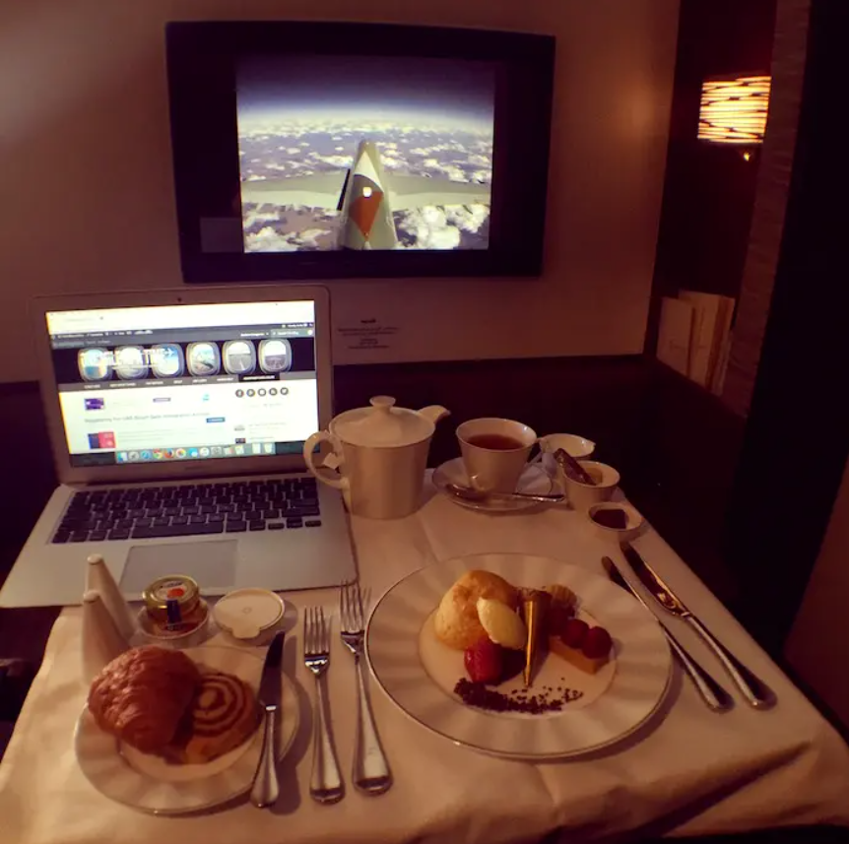
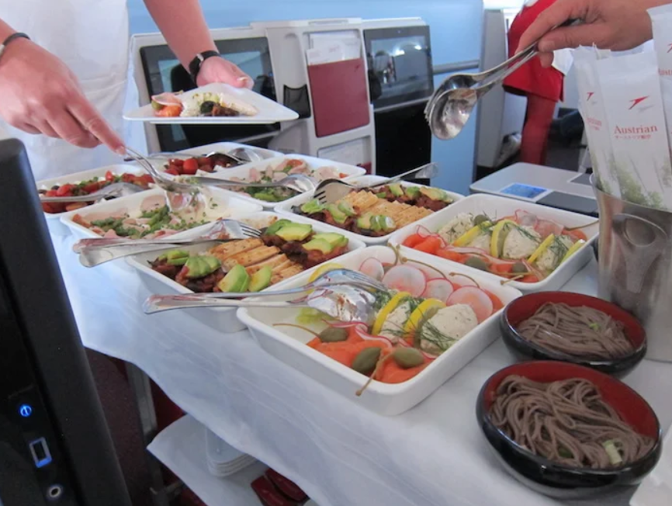
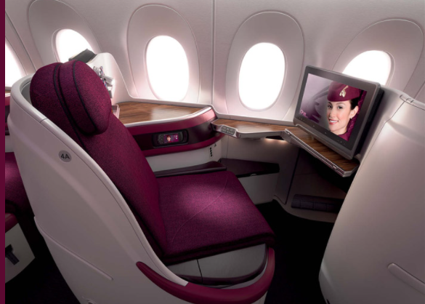
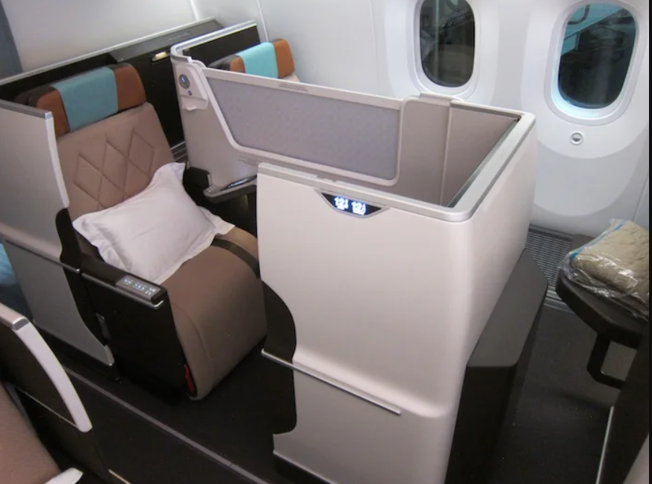
02
Fancy
Services

Slide 8

03
Quality

Slide 9

04
Competitive
Prices

Slide 10
02
Target Audience

Slide 11
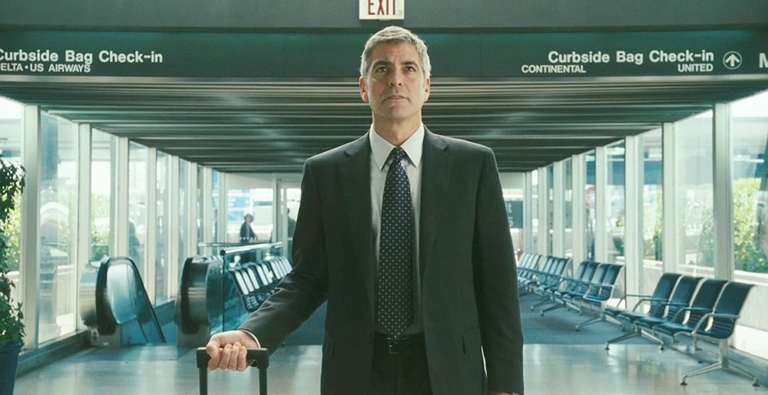


Slide 12
03
Media & Methods

Slide 13
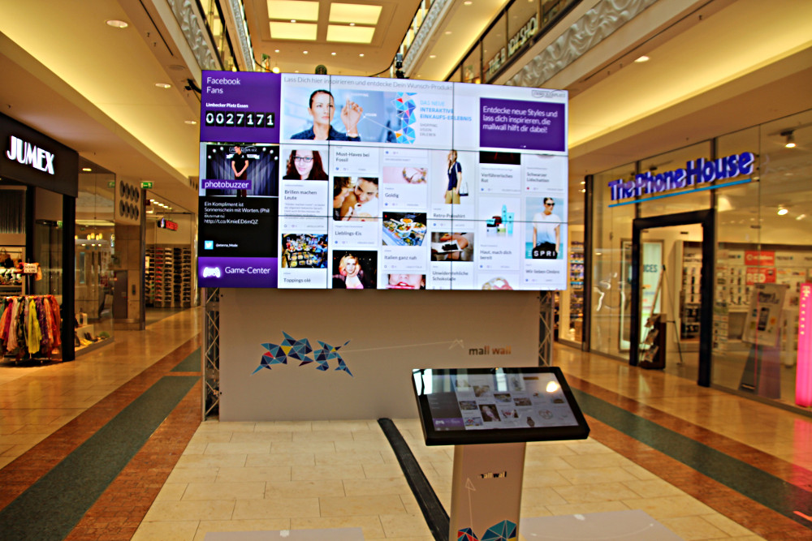

Fancy malls
Social Media platforms
TV and Radio

Slide 14
04
Celebrity Endorsements

Slide 15
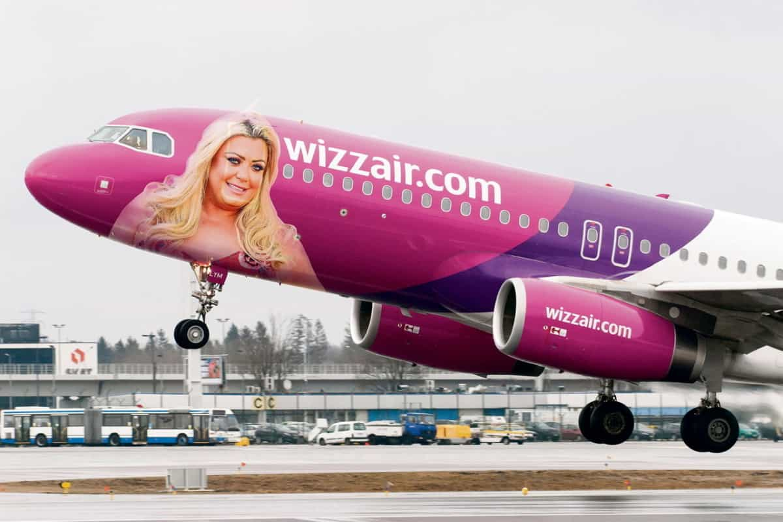
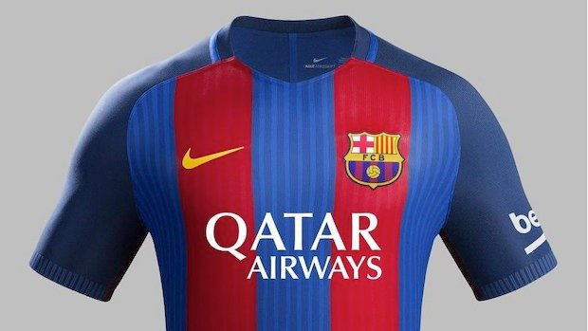

Slide 16

Thank you!

